Slide 1
Introduction to CUDA
CAP 4730
Spring 2012
Tushar Athawale

Slide 2
Resources
CUDA Programming Guide
Programming Massively Parallel Processors: A Hands-on Approach
- David Kirk

Slide 3
Motivation
Process independent tasks in parallel for a given application.
How can we modify line drawing routine?
a)Divide line into parts and assign each part to each processor.
b)What if we assign a processor per scanline?
(Each processor knows its own y coordinate)

Slide 4
Squaring Array Elements
Consider Array of 8 elements
Array sitting in the host(CPU) memory
Void host_square(float* h_A)
{
For(I =0; I < 8; I ++ )
h_A[I] = h_A[I] * h_A[I]
}

Slide 5
Squaring Array Elements
Array Sitting in the Device(GPU) memory
(Also called as Global Memory)
Spawn the threads
Each thread automatically gets a number
Programmer controls how much work each thread will do. e.g(in our current example)
4 threads - each thread squares 2 elements
8 threads – each thread squares 1 element.

Slide 6
Squaring Array Elements
Consider 8 threads are spawned by programmer, where each thread squares 1 element.
Each thread automatically gets a number
(0,0,0) (1,0,0) (2,0,0) … (7,0,0) in registers corresponding to each thread.
These built in registers are called ThreadIdx.x ,ThreadIdx.y, ThreadIdx.z

Slide 7
Squaring Array Elements
Write a program for only 1 thread
Following program will be executed for each thread in parallel
_global_ void device_square(float* d_A)
{
myid = ThreadIdx.x;
d_A[myid] = d_A[myid] * d_A[myid];
}

Slide 8
Squaring Array Elements
Block Level Parallelism?
Suppose programmer decides to visualize array of 8 elements as 2 blocks
BlockId’s are stored in built in BlockIdx.x, BlockIdx.y, BlockIdx.z
BlockID (0,0,0) (1,0,0)
ThreadID (0,0,0) .. (3,0,0) (0,0,0)..(3,0,0)

Slide 9
Squaring Array Elements
Here each thread knows its own blockID
and ThreadId
Int BLOCK_SIZE = 4;
_global_ void device_square(float* d_A)
{
myid = BlockIdx.x*BLOCK_SIZE +ThreadIdx.x;
d_A[myid] = d_A[myid] * d_A[myid];
}

Slide 10
General flow of .cu file
Allocate host memory(malloc) for Array h_A
Initialize that Array
Allocate device memory(cudaMalloc) for Array d_A
Transfer data from host to device memory(cudaMemCpy)
Specify kernel execution Configuaration (This is very important. Depending upon it blocks and threads automatically get assigned numbers)
Call Kernel
Transfer result from device to host memory(cudaMemCpy)
Deallocate host(free) and device(cudaFree) memories

Slide 11
GPGPU
What is GPGPU?
  General purpose computing on GPUs
Why GPGPU?
  Massively parallel computing power
  Hundreds of cores, thousands of concurrent threads
  Inexpensive

Slide 12
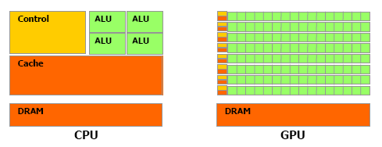
CPU v/s GPU
© NVIDIA Corporation 2009

Slide 13
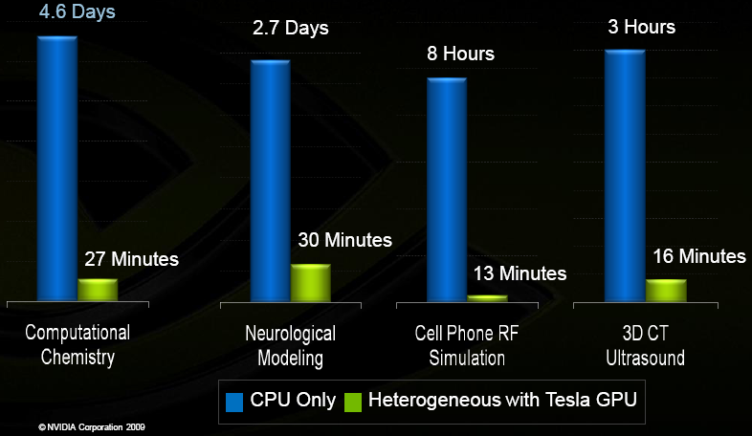
CPU v/s GPU
© NVIDIA Corporation 2009

Slide 14
GPGPU
How?
  CUDA
  OpenCL
  DirectCompute

Slide 15
CUDA
‘Compute Unified Device Architecture’
Heterogeneous serial-parallel computing
Scalable programming model
C for CUDA – extension to C

Slide 16
C for CUDA
Both serial (CPU) and parallel (GPU) code
Kernel – function that executes on GPU
__global__ void matrix_mul(…){}
matrix_mul<<<dimGrid, dimBlock>>>(…)
Array Squaring – (our example of 8 elements)
device_square<<<2, 4>>>(float* d_A)
File has extension ‘.cu’

Slide 17
C for CUDA
__global__ void matrix_mul(…){
…
[GPU (Parallel) code]
…
}
void main(){
…
[CPU (serial) code]
…
matrix_mul<<<dimGrid, dimBlock>>>(…)
…
[CPU (serial) code]
…
}

Slide 18
Compiling
Use nvcc to compile .cu files
  nvcc –o runme kernel.cu
Use –c option to generate .obj files
  nvcc –c kernel.cu
  g++ –c main.cpp
  g++ –o runme *.o

Slide 19
Programming Model
SIMT (Single Instruction Multiple Threads)
Threads run in groups of 32 called warps
Every thread in a warp executes the same instruction at a time

Slide 20
Programming Model
A single kernel executed by several threads
Threads are grouped into ‘blocks’
Kernel launches a ‘grid’ of thread blocks

Slide 21
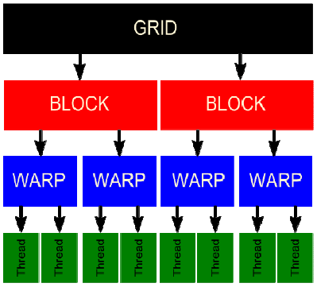
Programming Model
© NVIDIA Corporation

Slide 22
Programming Model
All threads within a block can
  Share data through ‘Shared Memory’
  Synchronize using ‘_syncthreads()’
Threads and Blocks have unique IDs
  Available through special variables

Slide 23
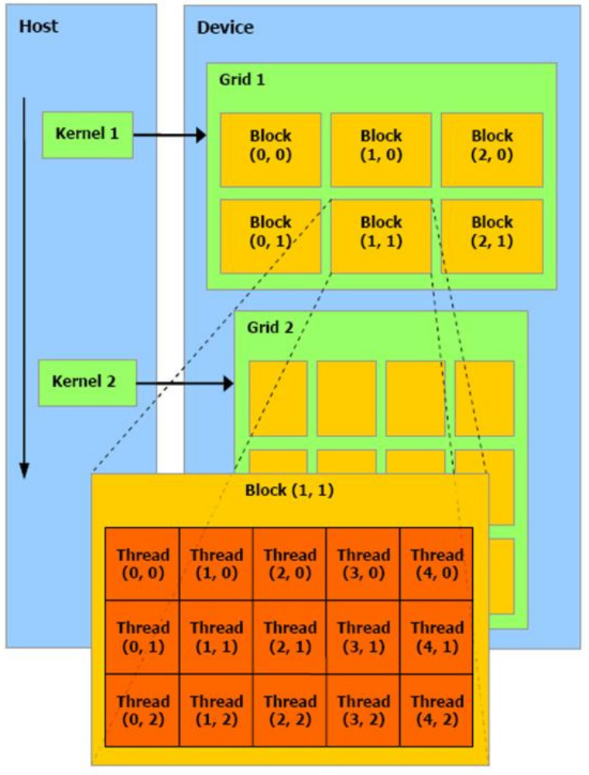
Programming Model
© NVIDIA Corporation

Slide 24
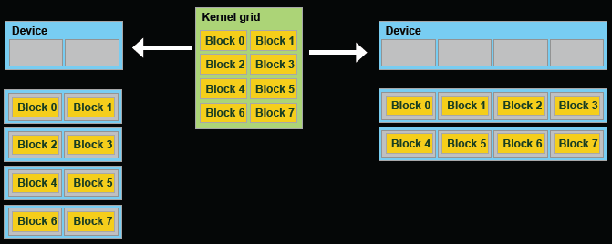
Transparent Scalability
Hardware is free to schedule thread blocks on any processor
© NVIDIA Corporation 2009

Slide 25
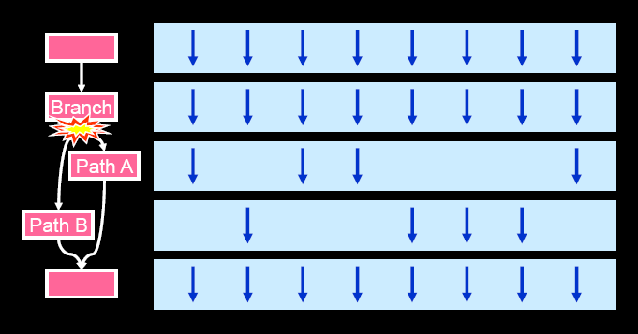
Control Flow Divergence
Courtesy Fung et al. MICRO ‘07

Slide 26
Memory Model
Host (CPU) and device (GPU) have separate memory spaces
Host manages memory on device
  Use functions to allocate/set/copy/free memory on device
  Similar to C functions

Slide 27
Memory Model
Types of device memory
  Registers – read/write per-thread
  Local Memory – read/write per-thread
  Shared Memory – read/write per-block
  Global Memory – read/write across grids
  Constant Memory – read across grids
  Texture Memory – read across grids

Slide 28
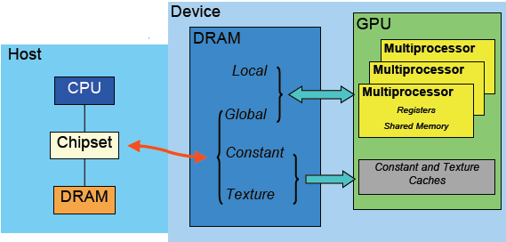
Memory Model
© NVIDIA Corporation

Slide 29
Memory Model
Block (0,0)
Block (1,0)
Shared Memory
Shared Memory
Registers
Registers
Registers
Registers
Thread (0,0)
Thread (1,0)
Thread (0,0)
Thread (1,0)
Local
Memory
Local
Memory
Local
Memory
Local
Memory
Host
Global
Memory
Constant
Memory
Texture
Memory
© NVIDIA Corporation

Slide 30
Thank you
http://developer.download.nvidia.com/presentations/2009/SIGGRAPH/Alternative_Rendering_Pipelines.mp4

